Slide 1







PYTHON
BEGINNER TO EXPERT
1
Copyright © 2021 TalentLabs Limited

Slide 2


Agenda
Basics of Python
▹ Installation
▹ Variables
▹ Keywords
▹ Data types
▹ Operators/Operands
Python Loops, Functions, & File Handling
▹ Loops
▹ Functions
▹ Lambda Functions
▹ Map, Reduce, & Filter
▹ File Handling
Python Data Structures
▹ Sets
▹ Lists
▹ Dictionaries
▹ Tuples
Python Exception
Handling
Iterators & Generators

Slide 3


Introduction
Open Source general purpose programming language
Object Oriented
Programming as well as scripting language
“Python is a general-purpose programming language that is often applied in scripting roles”
Features
Easy to learn & use
Interpreted language
Open Source
Large Standard Library
Large Community Support
Extensible
Cross-platform language

Slide 4
PYTHON vs
OTHER PROGRAMMING LANGUAGES
MORE USER-FRIENDLY
MORE APPLICATIONS STABILITY
SPEED

Slide 5

Why Spark?
In the industry, there is a need for a general-purpose cluster computing tool as:
➢ Hadoop Map-Reduce can only perform batch processing.
➢ Apache Storm / S4 can only perform stream processing.
➢ Apache Impala / Apache Tez can only perform interactive processing
➢ Neo4j / Apache Giraph can only perform graph processing
5
© zepanalytics.com
1. Basics of Python
Let’s start with the first chapter

Slide 6

Installation
Install Python on your machine.
You can download from the official website
https://www.python.org/downloads
Install Anaconda
https://www.anaconda.com/download

Slide 7
Variables
You can consider a variable to be a temporary storage space where you can keep
changing values.
Assigning values to a variable:
To assign values to a variable in Python, we will use the assignment (=) operator.
a = 10, a = “Welcome to the class”
No need to declare the datatype of the variables done in other programming
languages

Slide 8
Keywords
Special reserved words which convey a special meaning to interpreter or
compiler.
It can’t be used as a variable.
Few of the example keywords are as follows:
def, else, if, class, continue, break, finally, from, return, lambda, except,
import, None

Slide 9
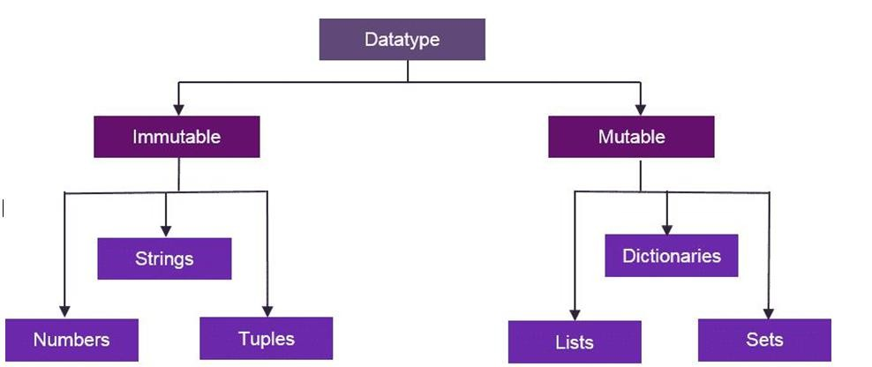
Data Types
Variables hold values of different data types.
With the help of type() function you can check the type of
variable used.

Slide 10
Operators & Operands
Operators are special symbols that represent computations like addition and multiplication.
Value of operators is applied to are called operands.
Operator : -, +, /,*,**
20+32, hour-1, hour*60+minute 5**2
- Order of Precedence : PEMD (Parenthesis, Exponentiation, Multiplication and Operators)

Slide 11


2. Python Data
Why Spark?
In the industry, there is a need for a general-purpose cluster computing tool as:
➢ Hadoop Map-Reduce can only perform batch processing.
➢ Apache Storm / S4 can only perform stream processing.
➢ Apache Impala / Apache Tez can only perform interactive processing
➢ Neo4j / Apache Giraph can only perform graph processing
11
© zepanalytics.com
Structure
Let’s start with the second chapter

Slide 12
Lists
List is a sequence of values of any type.
Values in lists are called as elements or items. [10, 20, ‘Class’]
A list within another list is nested.
Lists are mutable.
It has variable length.
Lists are accessed similarly like arrays. First element will be stored at 0th index.
Let’s discuss function used in lists.

Slide 13
Tuples
Tuples are similar like lists, having a sequence of values of any type and enclosed within parentheses.
Tuples are immutable.
It has fixed length.
tup_1 = (‘a’, 1, ‘df’, ‘b’)
Let’s discuss about the functions of tuples.

Slide 14

List vs Tuples
List
Tuple
Items surrounded in square brackets []
Lists are mutable in nature
There are more than 40 available methods in Lists.
If content is not fixed, and keeps on
changing then we should go for lists.
List objects cannot be used as keys for dictionaries because keys should be Hash table and immutable.
Items surrounded in round brackets ()
Tuples are immutable in nature
There are almost 30-35 available methods in Tuples.
If content is fixed, and never changes then we should go for Tuples.
Tuple objects can be used as keys for
dictionaries because keys should be Hash
table and immutable.

Slide 15
Sets
Unordered collection of items is known as set.
Items of set can not be duplicate. Colors = { ‘red’, ‘blue’ , ‘green’ }
Let’s see how to use, Union, Intersection methods in set.
Let’s discuss about the other functions of Sets.

Slide 16
Dictionary
Unordered collection of data.
Data in dictionary is stored as key:value pair.
Key should not be mutable and value can be of any type.
Dict = { “name”: “begindatum”, ‘age’:10 } Keys: name and age
Values: begindatum and 10
- Let’s see how to access the keys and values in dictionary along with different functions used.

Slide 17
3. Python Loops,
Why Spark?
In the industry, there is a need for a general-purpose cluster computing tool as:
➢ Hadoop Map-Reduce can only perform batch processing.
➢ Apache Storm / S4 can only perform stream processing.
➢ Apache Impala / Apache Tez can only perform interactive processing
➢ Neo4j / Apache Giraph can only perform graph processing
17
© zepanalytics.com
Functions & File
Handling
Let’s start with the third chapter
17

Slide 18
Loops
For loop
for index in sequence:
statements
for i in range(1,10): print(i)
for i in range(0,5): print(i)
else:print("for loop completely exhausted, since there is no break.");
Once for loop is executed, else block is also executed.

Slide 19
Functions
Function is a named-sequence of statements that performs some operations.
Example: type(32)
Here, name of function is type and expression in parenthesis is called argument of the function.
Type Conversion Function : Convert values from one type to another. Int can convert floating-point
values to integers and vice-versa
int(3.4545) 3

Slide 20
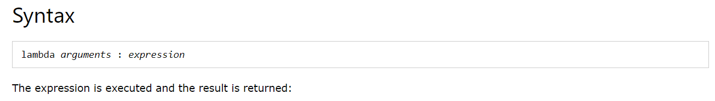
Lambda Function
Lambda Function is a small anonymous function which makes the developer’s life easier
It can take any number of arguments, but can only have one expression.

Slide 21
Map, Reduce & Filter
Map → Utility function, maps a collection to another collection object based on certain functionality.
map(function, iterable object)
For example: If we have list of people like: firstname = ["Ram", "Shyam", "Vinay", "Gopal"]
Map the list to obtain the names in upper case
list(map(lambda x:x.upper(), firstname))

Slide 22
Map, Reduce & Filter
Filter→ Similar function, but it requires the function to look for a condition and then returns only those elements from the collection that satisfies the condition.
Reduce → An operation that breaks down the entire process into pair-wise operations and uses the result from each operation, with the successive element.
Filter→
Data = [d1,d2,.....,dn]
filter(f, data)
Reduce → Function = f(x,y) reduce(f,data):
Step 1: val1 = f(d1,d2) Step 2: val2 = f(val1, d3)
Step n-1: val(n-1) = f(val(n-2), dn)

Slide 23
File Handling
Let’s see how to read and write with the files in Python. We will use basic functions and
methods like open(), read(), close() to perform the file manipulation.
file object = open(file_name [, access_mode][, buffering])
Fileopen = open(“filename”, “r”) Fileopen.close() Fileopen.read()
Fileopen.readline() // Read lines of the file Fileopen.write(“Welcome to the class”)
Let’s see the programs for file operations.

Slide 24
4. Python Exception
Why Spark?
In the industry, there is a need for a general-purpose cluster computing tool as:
➢ Hadoop Map-Reduce can only perform batch processing.
➢ Apache Storm / S4 can only perform stream processing.
➢ Apache Impala / Apache Tez can only perform interactive processing
➢ Neo4j / Apache Giraph can only perform graph processing
24
© zepanalytics.com
Handling
Let’s start with the fourth chapter

Slide 25
Exception Handling
An exception is an abnormal condition or error that occurs during the execution of program.
Some common exceptions are as follows:
NameError
ZeroDivisionError
Indentation Error
IO Error
Let’s see how to use try, catch, except and finally to handle the exceptions.

Slide 26
5. Iterators
Why Spark?
In the industry, there is a need for a general-purpose cluster computing tool as:
➢ Hadoop Map-Reduce can only perform batch processing.
➢ Apache Storm / S4 can only perform stream processing.
➢ Apache Impala / Apache Tez can only perform interactive processing
➢ Neo4j / Apache Giraph can only perform graph processing
26
© zepanalytics.com
&
🟏enerators
Let’s start with the fifth chapter

Slide 27
Iterators
Iterator in Python is simply an object that can be iterated upon. An object which will
return data, one element at a time.
It implement two special methods, iter () and next (), together called the iterator protocol.
Let’s understand more in detail with help of the program.
Generators
Python Generators are simple way of creating iterators. Basically, it is a function that
returns an object (iterator) which we can iterate over (one value at a time).
If a function contains at least one yield statement (it may contain yield or return statements), it becomes a generator function.
The difference, is that, while a return statement terminates a function entirely, yield statement pauses the function saving all its states and later continues from there on successive calls.
Let’s understand in more details with help of program

Slide 28
6. Python for Data
Why Spark?
In the industry, there is a need for a general-purpose cluster computing tool as:
➢ Hadoop Map-Reduce can only perform batch processing.
➢ Apache Storm / S4 can only perform stream processing.
➢ Apache Impala / Apache Tez can only perform interactive processing
➢ Neo4j / Apache Giraph can only perform graph processing
28
© zepanalytics.com
Science
Let’s start with the sixth chapter

Slide 29
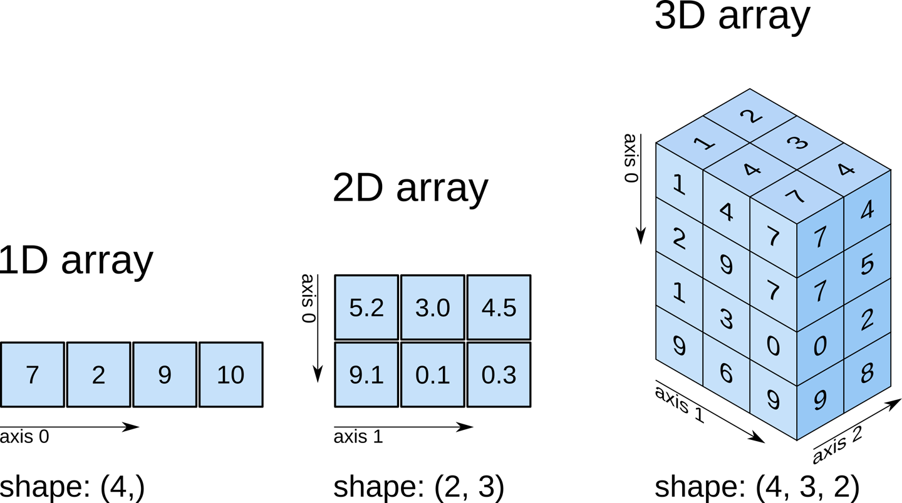
NumPy

Slide 30
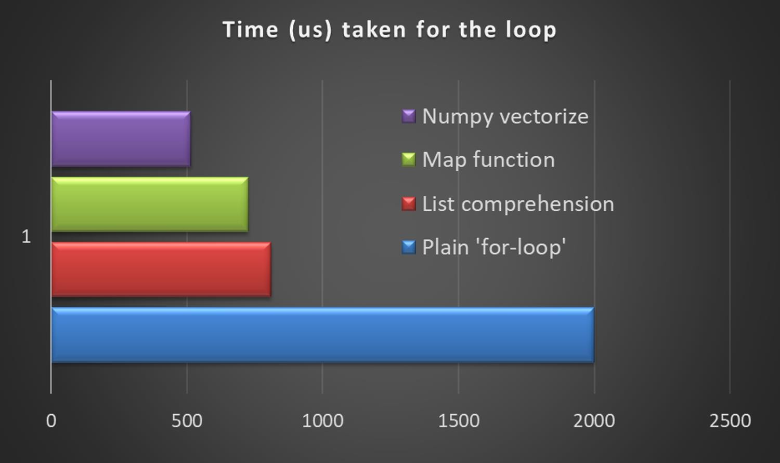
NumPy

Slide 31
NumPy
It is used for computation and processing of single and multi dimensional array of elements.
Smaller memory consumption and better runtime behavior.
To install the module: pip install numpy
To use NumPy : import numpy as np
values = [20.1, 20.4, 12.3, 43.5, 54.4, 23.5]
Convert = np.array(values)
print(Convert)
print(Convert+20)
Let’s see more examples on this.

Slide 32
Pandas
Pandas is fast, powerful, flexible and easy to use open source data analysis and manipulation tool. To install pandas: pip install pandas
Used to handle the data for single and multi-dimensional data structure.
Creates the powerful data frame.
Data frame is two-dimensional array used to store data whereas Series is one-dimensional array.
Let’s see more practical use of Pandas.

Slide 33
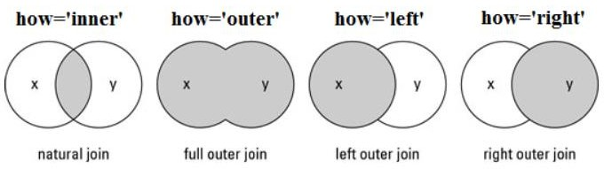
Pandas
Combining data frames
Merge:merge(left_df, right_df, on=’Customer_id’, how=’inner’)
Concat:
frames = [df1, df2]
result = pd.concat(frames)

Slide 34
Matplotlib
Graphical Representation of the values
To install: pip install matplotlib
To use in program: import matplotlib
Let’s say if we have to populate our previous lists, we can use: Import matplotlib.pyplot as plt
Plt.plot(Convert) Plt.show()

Slide 35
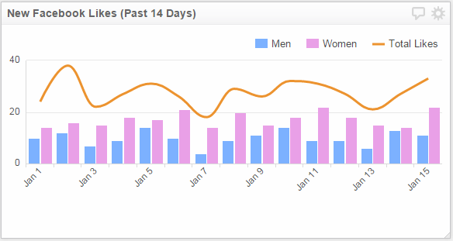
Matplotlib
Bar Graph
Helps to visualize a numeric feature

Slide 36
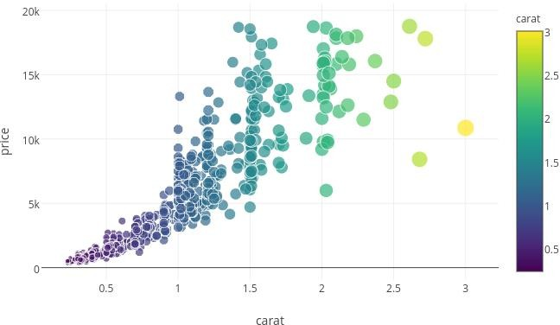
Matplotlib
Scatter Plot

Slide 37
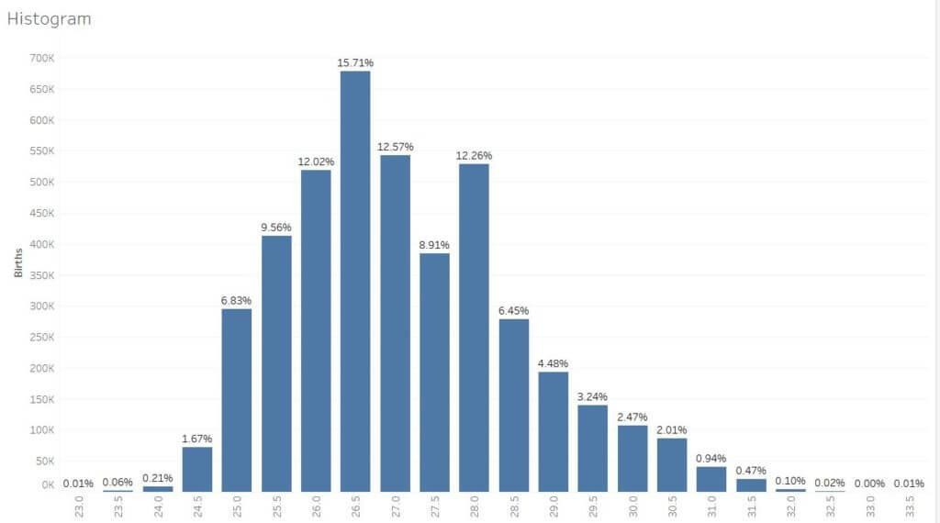
Matplotlib
Histogram

Slide 38
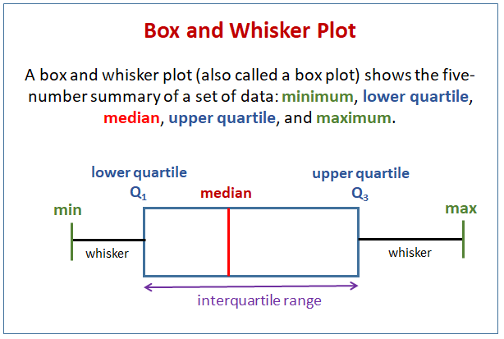
Matplotlib
Box Plot

Slide 39
Thank you
39

